Slide 1
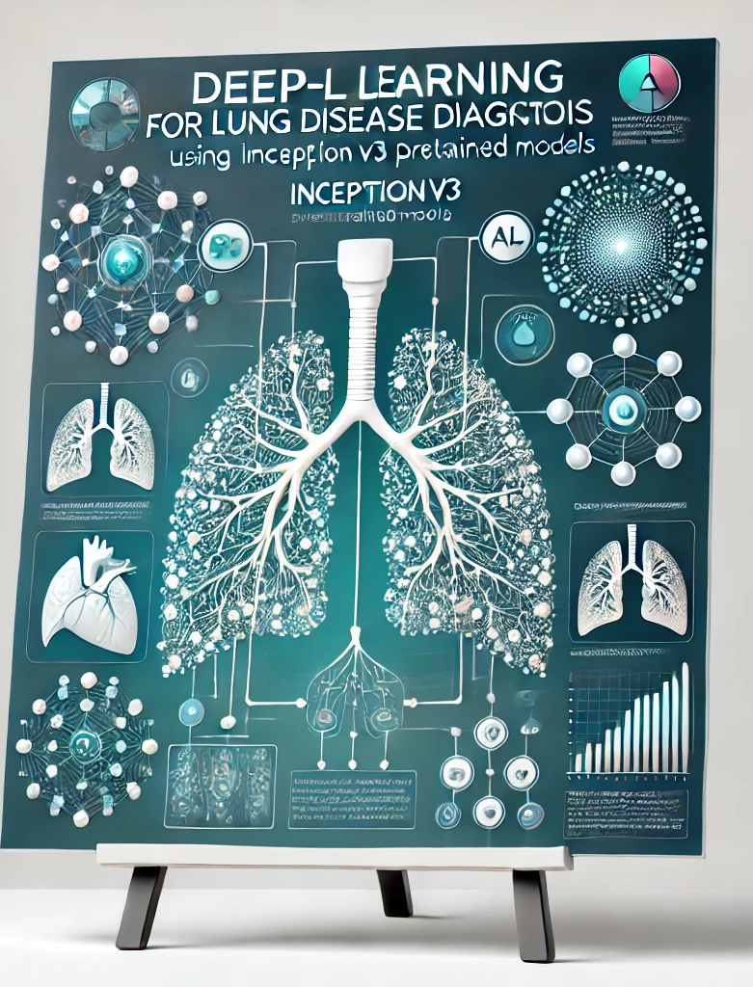
Deep Learning for Lung Disease Diagnosis Leveraging Inception Pretrained Models V3
Venkateshwari Narayanan

Slide 2
Introduction
Machine learning-based system for classifying lung images to identify COVID-19 infections, distinguishing them from healthy lungs and pneumonia-infected lungs.
To address this multi-class classification problem, we leverage the power of deep learning, specifically utilizing the Inception v3 model, which has been pre-trained on the ImageNet dataset. Fine-tuning this model enables it to adapt to the lung image classification task.
The system includes pre-processing steps to normalize and augment the dataset, model training and evaluates performance through metrics such as confusion matrix, and classification report.
The software achieves a training accuracy of 93%, validation and test accuracy of 90%, demonstrating its effectiveness.
Our results demonstrate that the proposed approach is capable of effectively classifying covid-19, pneumonia, and healthy lung images

Slide 3
Deep Neural Networks (DNNs) and Convolutional Neural Networks (CNNs)
This project is supervised learning refers to a model being trained on a labelled dataset where the desired output is provided, and the model learns to map inputs to outputs.
DNNs are a class of artificial neural networks that consist of multiple layers, which help in learning hierarchical features from the data. While DNNs work well for many general tasks, they struggle when it comes to processing image data. This is where CNNs come into play.
CNNs are specifically designed for image-related tasks, and they utilize convolutional layers to automatically detect features like edges, textures, and patterns in an image. Additionally, pooling layers help in reducing the dimensionality of the feature maps, making the model more computationally efficient and capable of detecting hierarchical features.
For this project, we focus on using a pretrained inceptionv3 model. The inceptionv3 model, known for its efficiency in image classification tasks, has been pre-trained on the ImageNet dataset

Slide 4
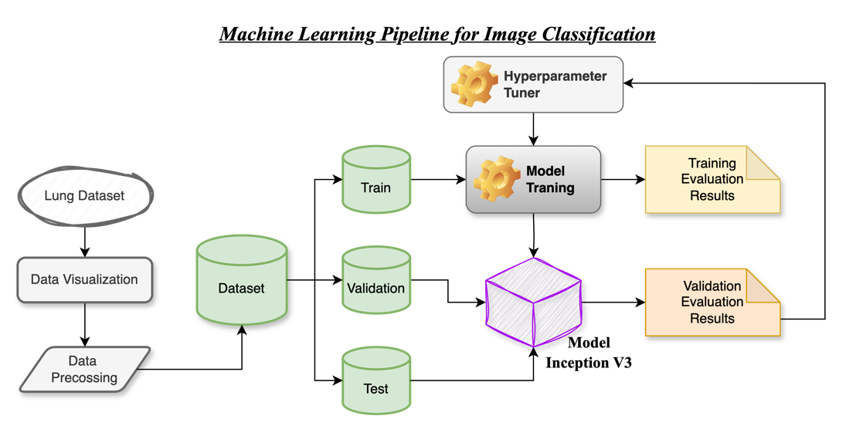

Slide 5

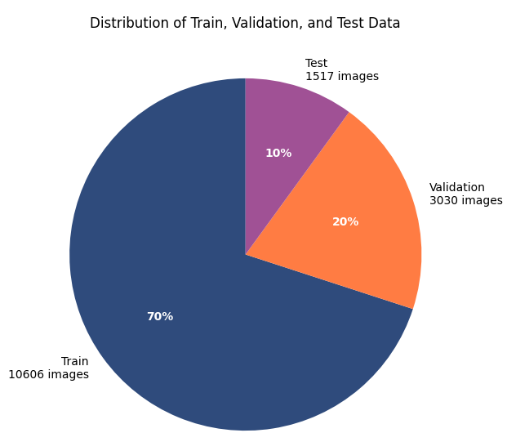
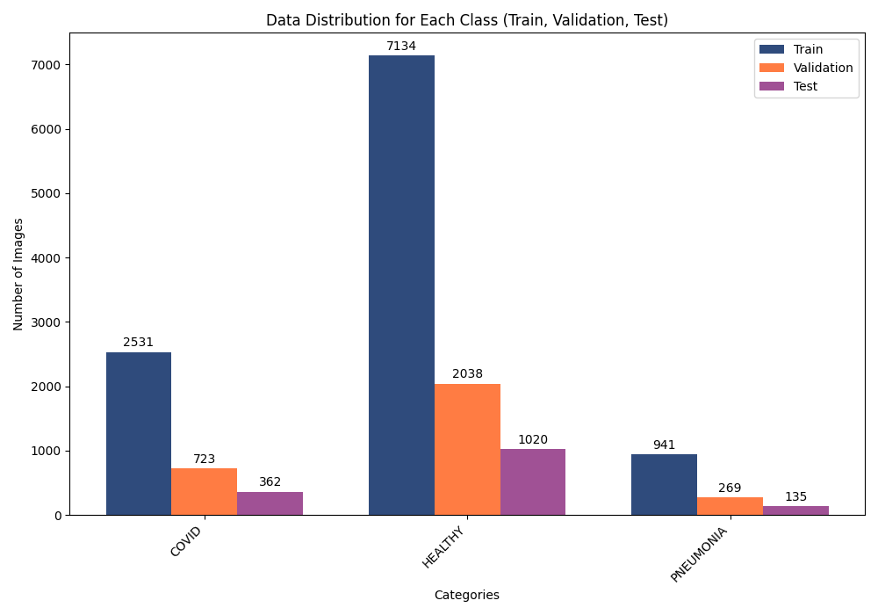
Data Distribution

Slide 6
Data Pre-processing
The aim is to prepare raw image data for model training and evaluation.
Image normalization - image normalization ensures that pixel values are scaled to a consistent range, improving the model's convergence during training.
Data augmentation is used to artificially increase the diversity of the training dataset by applying random transformations to the images. This approach helps the model generalize better to unseen data and reduces overfitting.
Unlike the training data, the validation dataset is not augmented. The purpose of validation is to evaluate the model's performance on a consistent dataset. Applying augmentation to validation data could introduce random variations, making evaluation inconsistent. Instead, the validation data is rescaled to the [0,1] range for normalization.
The test dataset is treated similarly to the validation dataset, with no data augmentation applied. The test set is used for the final evaluation of the model's performance and must represent the original distribution of the data without random transformations.

Slide 7
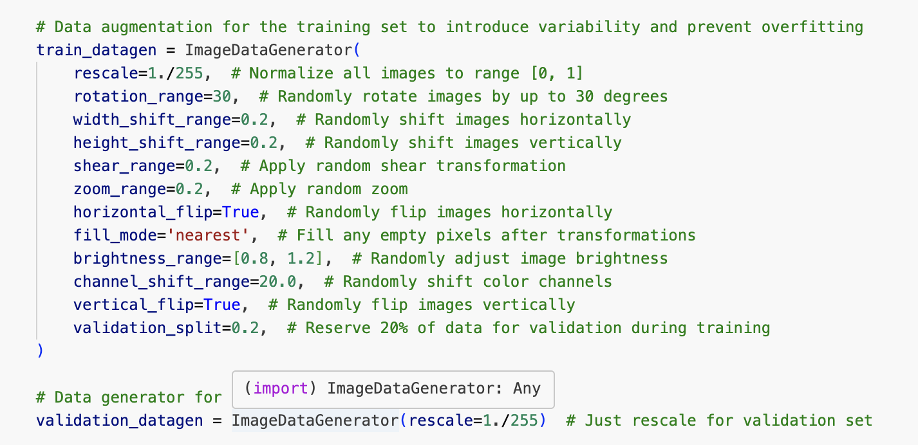
Data Augmentation

Slide 8
Data Generator
This method reads images directly from the disk, applies the specified preprocessing and augmentation techniques, and generates batches of data for training, validation, and testing.
Training, validation and test dataset are configured as follows:
Image resizing: all images were resized to 331x331 pixels to meet the input size requirements of the inceptionv3 model.
Batch size: a batch size of 128 was chosen to balance computational efficiency and memory usage.
Class mode: set to categorical, ensuring the class labels were one-hot encoded for multi-class classification.
This systematic approach to loading and pre-processing ensured that all datasets were prepared efficiently and consistently, facilitating smooth integration with the deep learning pipeline.

Slide 9
Model Selection
For this project, we selected InceptionV3, a pre-trained CNN model, due to its proven effectiveness in image classification tasks and its efficient architecture.
Key features of InceptionV3 include:
Factorized Convolutions: Breaks down large convolutional filters into smaller ones to reduce computational cost without sacrificing performance.(instead of using a large 5x5 convolution, InceptionV3 uses two 3x3 convolutions)
Auxiliary Classifiers: Intermediate SoftMax layers that help mitigate the vanishing gradient problem and improve convergence during training.
Batch Normalization: Applied extensively throughout the network to stabilize and accelerate training.
Global Average Pooling: Replaces fully connected layers at the end of the network, reducing the total number of parameters and preventing overfitting.

Slide 10
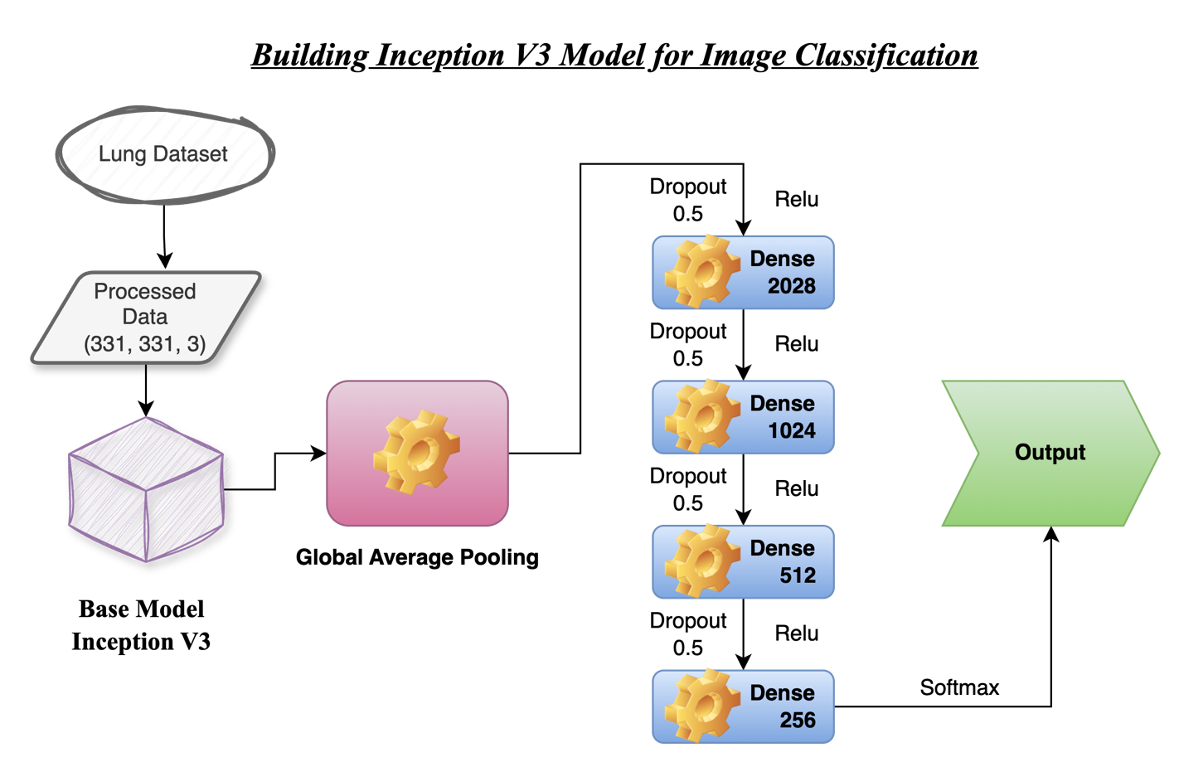
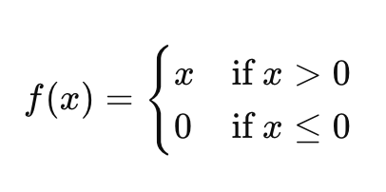
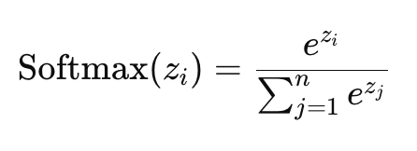
Learning Rate: 0.001

Slide 11
Model Optimization Experiments
Learning Rate – 0.001
Batch Size – 128 Size
Dropout – 0.5
Input Image Resolution – 331 * 331
Inclusion of Dense Layers – 2028, 1024, 512 & 256
Activation Function – Relu
Experimenting Different Pretained Models – Inception V3 model
Early Stopping – 30 Patience
Pooling Layer – Global Average Pooling Layer

Slide 12


Model Training
The compiled InceptionV3 model was trained using the Adam optimizer with a learning rate of 0.001, and categorical cross-entropy was selected as the loss function to suit the multi-class classification task.
The training process was carried out using the following parameters:
Batch Size: Batch size of 128
Epochs: Training was set to a maximum of 40 epochs. Early stopping was applied to halt training if the validation loss did not improve for 30 consecutive epochs, thereby preventing overfitting and reducing unnecessary computation.
Steps per Epoch: This parameter specifies the number of batches the model processes for one epoch.
Validation Steps: Like steps per epoch, this parameter was calculated for the validation dataset.

Slide 13
Model Evaluation
The model evaluation process involves assessing the model's performance on training, validation, and test datasets.
Accuracy and Loss Value – Based on the Training and Validation Dataset
Confusion Matrix – Based on the Test Dataset
Classification Report – Based on the Test Dataset
Precision Value
Recall Value
F1-Score
Support value
Macro Average
Weighted Average

Slide 14
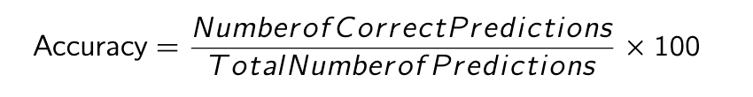
Accuracy and Loss
Loss: Measures the difference between the model's predictions and the actual values. A lower loss indicates that the model’s predictions are closer to the true labels.
Accuracy: Represents the proportion of correct predictions made by the model. It is calculated by dividing the number of correct predictions by the total number of predictions. A higher accuracy reflects better model performance.

Slide 15
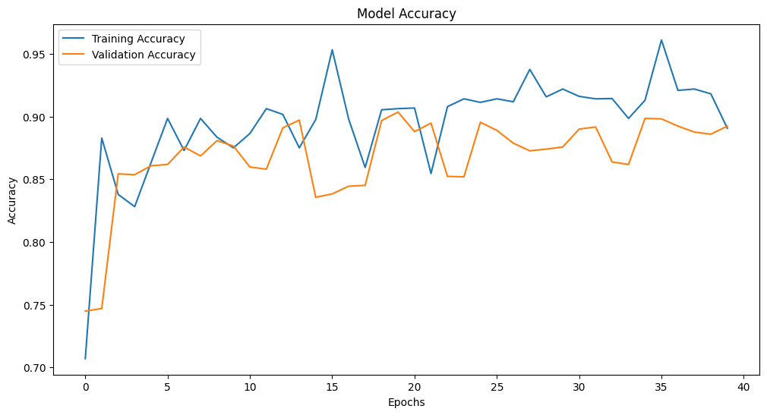
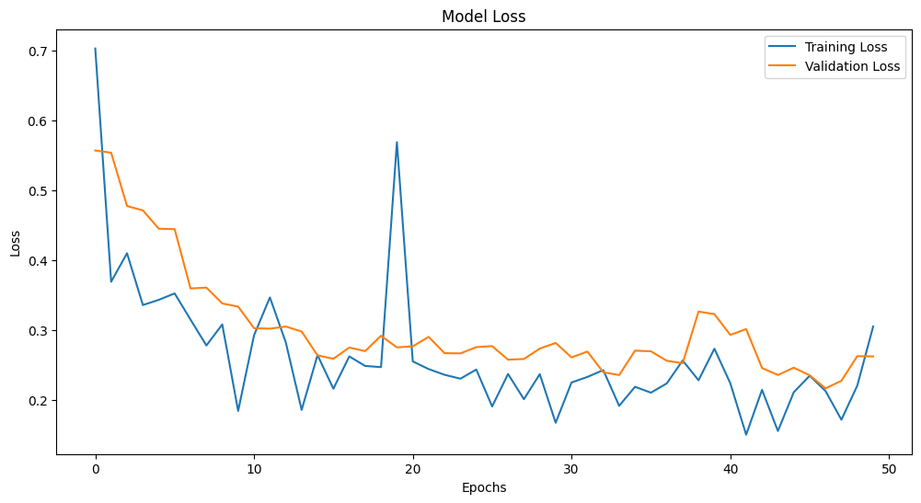
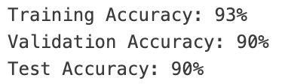
Training Accuracy and Loss: The training accuracy steadily increases across each epoch, and the loss consistently decreases, suggesting that the model is learning effectively from the training data. The slight difference between the training accuracy and loss with the validation metrics indicates that the model is neither overfitting nor underfitting.
Validation Accuracy and Loss: The validation accuracy shows a gradual increase, while the validation loss decreases steadily. This indicates that the model is generalizing well to unseen data, showing continuous improvement during training and confirming that it is not overly specialized to the training data.

Slide 16

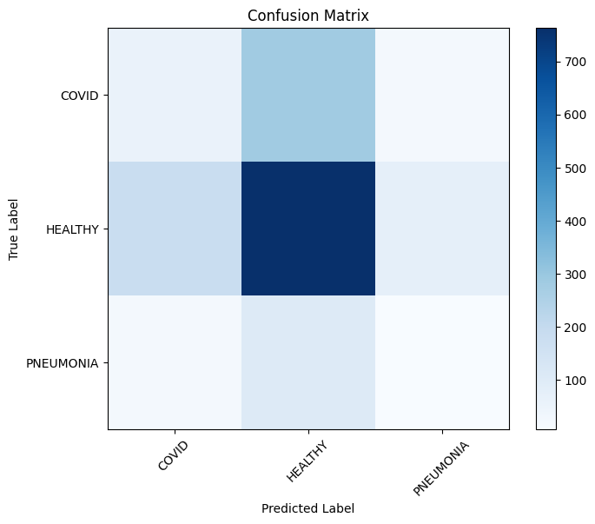
Confusion Matrix
It compares the predicted class labels with the true class labels.
The matrix is structured as follows:
Each row represents the true class (actual label).
Each column represents the predicted class (predicted label).
Matrix elements:
First row (true class 0):
56: correct predictions for class 0 (true positives).
284: instances of class 0 incorrectly predicted as class 1 (false positives).
22: instances of class 0 incorrectly predicted as class 2 (false positives).
Second row (true class 1):
183: instances of class 1 incorrectly predicted as class 0 (false negatives).
763: correct predictions for class 1 (true positives).
74: instances of class 1 incorrectly predicted as class 2 (false positives).
Third row (true class 2):
22: instances of class 2 incorrectly predicted as class 0 (false negatives).
106: instances of class 2 incorrectly predicted as class 1 (false negatives).
7: correct predictions for class 2 (true positives).

Slide 17
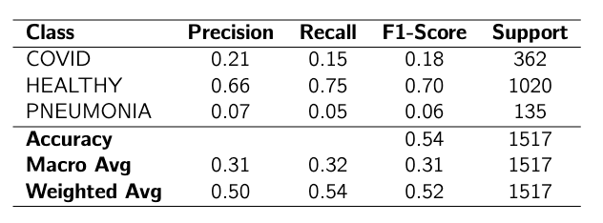
Classification Report

Slide 18

Precision Value
Precision is the proportion of true positive predictions out of all the instances predicted as positive.
Key Insights from Precision:
For COVID: Precision is 0.21, meaning that when the model predicts "COVID," it is correct 25% of the time.
For HEALTHY: Precision is 0.66, meaning that 66% of the time, when the model predicts "HEALTHY," it is correct.
For PNEUMONIA: Precision is 0.07, indicating a low percentage of correct predictions for "PNEUMONIA."

Slide 19

Recall Value
Recall is the proportion of actual positives that are correctly identified by the model.
Key Insights from Recall:
For COVID: Recall is 0.15, meaning the model identifies 15% of all actual "COVID" cases.
For HEALTHY: Recall is 0.75, meaning the model correctly identifies 75% of all "HEALTHY" cases.
For PNEUMONIA: Recall is 0.05, indicating that the model fails to identify most "PNEUMONIA" cases.

Slide 20

F1-Score
The F1-score is the harmonic mean of precision and recall. It balances the trade-off between precision and recall.
Key Insights from F1-Score:
For COVID: The F1-score is 0.18, indicating a poor balance between precision and recall.
For HEALTHY: The F1-score is 0.70, showing a relatively better balance.
For PNEUMONIA: The F1-score is 0.06, indicating a very poor balance and performance.

Slide 21
Support, Macro Average & Weighted Average
Support value:
Support represents the number of true instances for each class in the dataset.
COVID has 362 instances, HEALTHY has 1020 instances, and PNEUMONIA has 135 instances in the dataset.
Macro Average:
The macro average calculates the average of the precision, recall, and F1-score for each class, treating all classes equally, regardless of their support.
The macro average precision, recall, and F1-score are all 0.32. This indicates that, when considering all classes equally, the model performs moderately poorly, particularly due to the low performance on the "PNEUMONIA" class.
Weighted Average:
The weighted average accounts for the support (number of instances) of each class and computes the average precision, recall, and F1-score, weighted by the support of each class.
The weighted average precision is 0.50, recall is 0.54, and F1-score is 0.52. These values are better than the macro average due to the larger support for the "HEALTHY" class, where the model performs well.

Slide 22
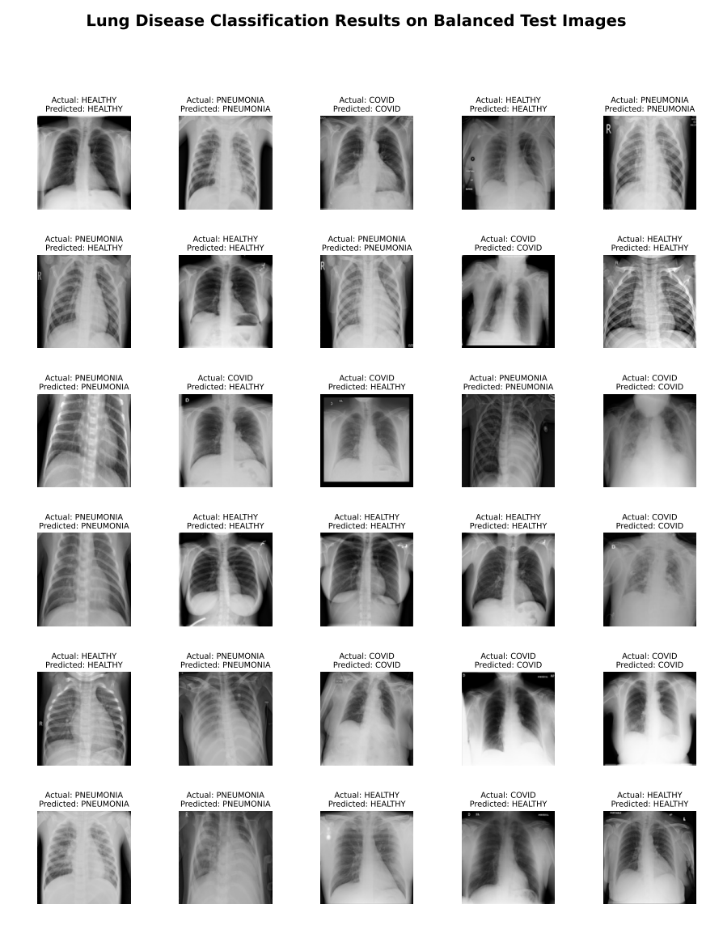
Model Prediction on Test Data
The saved trained InceptionV3 model was evaluated on a balanced subset of 30 test images, consisting of 10 images from each class: COVID, HEALTHY, and PNEUMONIA.
Out of 30 test images, 26 images were classified correctly, demonstrating the model’s robust performance on unseen data.

